Slide 1

Terror Texts
Christians in Conversation for Pride
All Hallows Leeds
2017
Rev’d Dr Jonathan Tallon
Notes:
All views expressed are the sole responsibility of Jonathan Tallon, and do not necessarily reflect the views of Northern Baptist College. I reserve the right to change my mind.

Slide 2
Some ground rules…
Please respect confidentiality.
Chatham House rules
Information disclosed during a meeting may be reported by those present, but the source of that information may not be explicitly or implicitly identified.
I waive my confidentiality.

Slide 3
Issues not covered directly today…
Transgender
Intersex
Queer
Bisexual
And not much on lesbianism.
Notes:
Always left out - but at least I’m acknowledging you’re left out…?!

Slide 4
Interpreting the Bible…
Trajectories…
Look which way the Bible is heading (slavery, women)
The Bible is on the side of the marginalised…
…gay & lesbian people are marginalised
We should be on the side of gay and lesbian people
But…
Assumes that practice isn’t sinful
…The terror texts
Notes:
Some of the arguments currently used by those in favour of changing the Church’s traditional understanding.

Slide 5
Interpreting the Bible…
This is X…
The bible condemns X…
Therefore we should condemn X
Mortgages are money-lending
The bible condemns money-lending
Therefore we should condemn mortgages
Calvin disagreed…
Notes:
The basic argument against change, and why it is less straightforward than might first appear.

Slide 6
Why we don’t…
Usury
Mortgage
Notes:
There is a difference between usury and having a mortgage, and it’s large enough so that we can treat the two differently.

Slide 7
So…
This is X
The bible condemns Y
X is similar to Y
Do we condemn X?
Notes:
The actual argument – note the difference. Are X and Y the same?

Slide 8
Homosexuality
There are committed, monogamous, same-sex relationships (and in Britain marriages)
The bible condemns same-sex activity in its contexts
How similar are the two?

Slide 9
Is it this…
Same-sex activity condemned in Bible
Faithful, monogamous same-sex relationships now

Slide 10
Or this…
Same-sex activity condemned in Bible
Faithful, monogamous same-sex relationships now

Slide 11
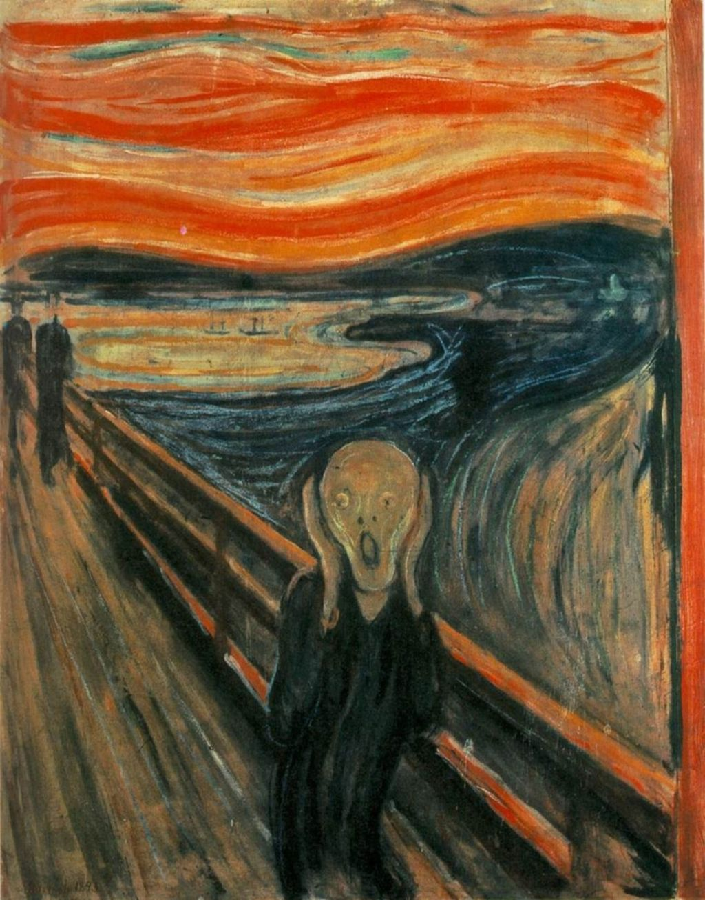
The Terror Texts…
Notes:
Phylis Trible (1984) Texts of Terror. Literary feminist readings of biblical narratives. Four narratives – Hagar, Tamar, unnamed woman in Judges, the daughter of Jephthah.
The terror texts for LGBTIQ…

Slide 12
The terror texts (& others)
Genesis 1 & 2
Genesis 19
Leviticus 18:22 & 20:13
The gospels
Romans 1:26-27
1 Corinthians 6:9 & 1 Timothy 1:10
Acts 10
Notes:
Sometimes called the clobber verses. The key verses usually end up being Genesis and Romans.

Slide 13
Genesis 1 & 2
‘It’s Adam and Eve,
not Adam and Steve!’

Slide 14
Genesis 1 & 2
²⁷ So God created humankind in his image, in the image of God he created them; male and female he created them. ²⁸God blessed them, and God said to them, ‘Be fruitful and multiply, and fill the earth and subdue it; and have dominion over the fish of the sea and over the birds of the air and over every living thing that moves upon the earth.’
18 Then the Lord God said, ‘It is not good that the man should be alone; I will make him a helper as his partner.’ …
Notes:
Issue – we have a narrative. But it has been read and interpreted in multiple ways over the centuries. Difficult to rely on details and place great weight on interpreting them.
Broad picture – God created humankind and blessed them, and marriage is blessed by God. If get too narrow – if a man gets married, and they stay with his parents, is it a real marriage?

Slide 15
Genesis 1 & 2
The ‘natural order’ of things?
Is procreation (being fruitful) necessary?
Is companionship enough?
Is physical complementarity necessary?
Notes:
The ‘natural order’ – universally? Certainly the most common, but is it a description of what God blesses, or a prescription – this, and this only. Danger of image of God being found only in married people with kids, and everyone else being second class.
‘Be fruitful’ – is procreation necessary? What about couples who can’t have children – can they still marry (10 year divorce rule in some forms of Judaism)? What about those who would like to marry but don’t meet the right person? Churches are full of single people – most do not feel called to celibacy. If this is emphasised, a danger of turning Christianity into a fertility cult.
Other views of ’be fruitful’ – responsibility of whole of humankind.
What about companionship? Is this enough (not good to be alone). What if your ideal companion would be the same sex?
Physical complementarity – is this necessary? Slot and tab view of humanity.
In each case, we also need to consider celibacy and couples who can’t have children; how does our reading affect them? Note also – what does being fruitful mean?

Slide 16
Genesis 19 – Sodom
‘God destroyed the men of Sodom on account of their sinful practice of homosexuality.’

Slide 17
Genesis 19 - Sodom
Attempted violent same-sex gang rape which abuses hospitality
Is every element in that condemned?
The Bible also condemns heterosexual rape (Judges 19 – one of Trible’s original texts of terror).
Rape – power, control and violence. Gender immaterial.
Notes:
Note that it is crimes against hospitality for which Sodom is condemned often elsewhere in the Bible. Note too that the gender of the victim appears immaterial. Compare it too with the similar account (heterosexual) that occurs at the end of Judges. Rape is an issue about power and control and violence, and doesn’t respect gender (consider the abuses at Abu Ghraib prison).

Slide 18
Leviticus 18:22 & 20:13
‘The bible, which I accept as the Word of God, makes it very clear that homosexuality is a sin. Please see Leviticus 18.22 and 20.13…’

Slide 19
Leviticus 18:22 & 20:13
^{18:22}You shall not lie with a male as with a woman; it is an abomination.
^{20:13}If a man lies with a male as with a woman, both of them have committed an abomination; they shall be put to death; their blood is upon them.

Slide 20
Leviticus 18:22 & 20:13
Part of the holiness code
Wool and linen
Milk and meat
Menstruation
Physical disability
Etc
Is it to do with not wasting sperm?
Note particular location – is the context Egyptian and Canaanite temple practice?
Notes:
At the time, the main acceptable form of same-sex activity in contemporary cultures was entwined with pagan worship (see Gagnon).
Note that women having sex aren’t mentioned anywhere. Judaism at the time rarely talked about women having sex with women, and when they did it wasn’t treated that seriously.

Slide 21
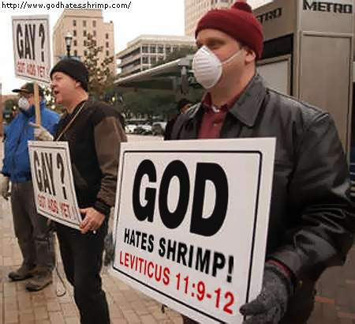
Leviticus 18:22 & 20:13
Why take only part of the verse seriously?
Why not take the rest of Leviticus seriously?
Notes:
Why don’t we put people to death? Why do we concentrate on these verses from the Law, when we eat ham and cheese sandwiches, sport tattoos, and generally consider we are free from the Law?

Slide 22
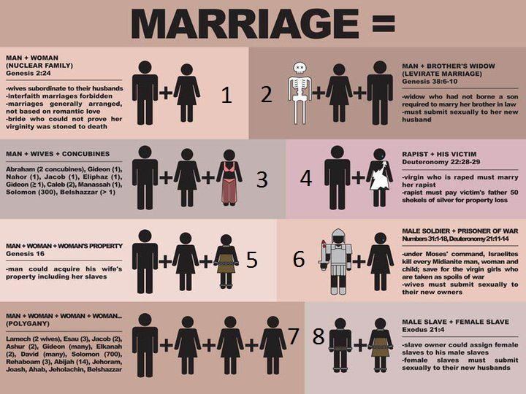
Old Testament marriage…
Notes:
Beware of having too rosy a view of marriage in the Old Testament. Polygamy, concubines, slaves, levirate marriage are all different from what would be acceptable today.

Slide 23
The gospels
’Did Jesus say anything about homosexuality? Of course, when asked about marriage, Jesus issued a sweeping condemnation of all sexual relationships outside of the male/female model established in Gen 1:27, which he specifically cited.’

Slide 24
The gospels
Notes:
I don’t think the gospels speak directly on this issue.
Arguments about what Jesus would say or do tend to rely on what the arguer thinks is the right answer.
Eg, Jesus accepted everyone, therefore Jesus accepts gays and lesbians. Yes, but he also told people to stop sinning. Is it sinful to have sex with someone who’s the same sex as you?
Eg, Jesus was a first century Jew, so of course he would condemn homosexuality. Yes, but he’s also God, so normal rules just don’t apply at all.
Two particular passages that get mentioned:
The centurion’s slave – a sexual partner? Perhaps. But we are not told enough to know. And it is not the type of relationship we would want to affirm in any case (master-slave).
Jesus affirming marriage (Mark 10) – yes. But this doesn’t mean he condemns all alternatives (eg celibacy!).
In short, arguments from the gospels often tell us more about the person presenting the argument than they do about what the Bible might say.

Slide 25
Sexual categories in the ancient world for freeborn male
Not heterosexual vs homosexual
Dominant vs submissive
Acceptable (and common) to have sex with anyone below you in status
  boys (freeborn in Greek culture, not Roman culture)
  Slaves (male or female)
  prostitutes
  actors
  bar staff
NOT freeborn women (adultery) unless your wife
Notes:
We need to understand the culture of New Testament times if we are to understand what the NT says about this issue.
There was no category of ‘homosexual’ in the ancient world. It was not the way they divided the world up. The term ‘homosexual’ only comes from the nineteenth century, and includes the idea of attraction to the same sex. The ancient world was based on action, not attraction. Any translation that uses ‘homosexual’ for a biblical passage is highly misleading.
The main sexual distinctions in the ancient world revolve around whether someone is the active, dominant, penetrating participant, or the passive, submissive, penetrated participant. Freeborn males are OK so long as they are the active, dominant partner, irrespective of the sex of the other partner, and so long as they are not dishonouring a freeborn woman (prostitutes, actors and bar staff have no honour, so cannot be dishonoured).

Slide 26
Attitudes to sex for free men
OK | Looked down on
Procreative sex
Anal sex
Prostitution
Sex with slaves
Sex with boys
Religious sex
 | Oral sex
 | Sex with ‘equal’
 | Sex with superior
OK | Looked down on
Procreative sex
 | Anal sex
 | Prostitution
 | Sex with slaves
 | Sex with boys
 | Religious sex
 | Oral sex
 | Sex with ‘equal’
 | Sex with superior
Greco-Roman
Jewish
Notes:
Note that ‘adultery’ is strictly defined – it is sex with a freeborn woman who isn’t your wife, and hence whom you are dishonouring. Sex with a prostitute is fine – they have no honour.
If we want the same sexual standards as Judaism of the time, we need to forgo contraceptives and become like the Roman Catholic Church. Otherwise, you are already using different standards.

Slide 27
Romans 1:26-27
‘You're no Bible bielieving [sic] Christian you filthy Sodomite!
This is your punishment
Romans 1:26 KJV.’

Slide 28
Romans 1:26-27
On account of this God handed them over to dishonourable passions: for both their females exchanged the natural usage for the usage against nature, likewise also the males, having left the natural usage of females, were burnt up in their desire for each other, males in males doing that which brought shame and receiving in themselves the due rewards which inevitably came from their going astray.
Notes:
Most translations get this wrong. Paul uses the word for ‘males’, not men. It’s potentially significant. Is it an allusion to Genesis? Or is it used because ‘males’ can include boys (older men with younger boys was the main form of same-sex intercourse within the culture)?

Slide 29
‘Against nature’ – means…
Excessive sexual desire
  (expressed in any way)
Sexual activity which doesn’t lead to procreation
  (oral, anal, contraception, infertile couples…)
Going against the natural order of things
  (which God does – Romans 11:24; long hair on a man – 1 Corinthians 11:14)
Out of the ordinary
  (eg a slave being loyal to the point of death for a master)
Notes:
‘Against nature’ could have a variety of meanings.

Slide 30
Against nature…
Is female-female sex in mind?
  Few references to lesbianism in Graeco-Roman culture
  Vanishingly small number in Jewish sources
Many references to oral and anal sex
Or any sex that ‘wasted’ sperm
  Contraception; women unable to have children (cf Philo)
Understood this way by various early church commentators (Clement, Augustine)
Notes:
There is a strong argument that Paul is not referring here to female same-sex activity. If he isn’t, then it isn’t mentioned in the Bible at all. Instead, he is referring to females having non-procreative sex (eg, anal sex). This passage wasn’t interpreted as meaning female-female sex until the late fourth century, and even then not by all commentators (eg Augustine assumed it referred to female-male ‘unnatural’ sex).

Slide 31
Paul’s argument
Critical failing – worshipping creation, not God
1:26-27 is the result of idolatry, and God’s judgment on idolatry
Why focus on same-sex activity?
What about those who worship God but are homosexual?
What type of same-sex activity is Paul condemning?
Activity must be acceptable to pagans, but not to Jews
Notes:
Paul’s argument is all about idolatry. How does same-sex activity fit in with this?
Note the last point – this is one reason why a reference here to female same-sex activity would be odd. It was looked down on by pagans as well as Jews.

Slide 32
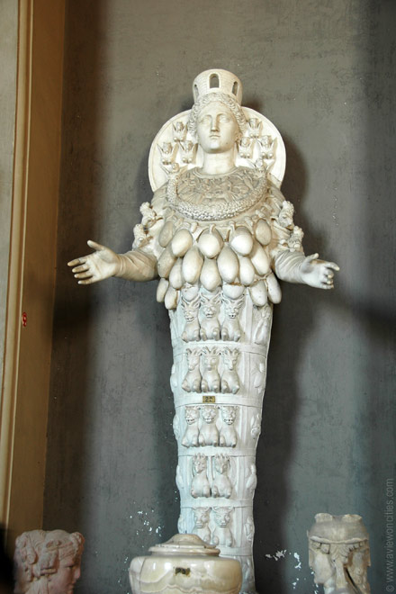
Possible context – cult of Cybele
The earth mother, or great mother
Associated with fertility
Associated with wife of Augustus
Prominent temple in Rome (18m x 30m)
Part of the official religious calendar
Linked with Artemis, Diana, Venus, Aphrodite, Isis, Ceres and others
Notes:
One interpretation – Paul in Rom. 1:26-27 is alluding to pagan worship, in particular of fertility goddesses (note how he ends up in trouble in Ephesus for undermining worship of Artemis).

Slide 33
The worship of Cybele
Ecstatic male followers
Self-castrated (‘…the due reward?’)
Called ‘galli’
Insulted as ‘dogs’ (see Philippians 3:2…)
Dressed as women
Also priestesses
Celebrations included orgies
(at least in Jewish rhetoric)
Male galli penetrated
Female galli used phalluses to penetrate men
Notes:
The worship of Cybele (and some other fertility goddesses) was accused of involving sexual orgies where the priestesses would penetrate the male followers (galli) with phalluses. They in turn would also penetrate each other, and also self-castrate, before running through the streets throwing parts they had cut off at bystanders.
How does this fit in with Romans? It explains why Paul mentions females first (priestesses were in charge of the pagan cult); it explains exchanging natural for unnatural usage (penetration using phalluses); it explains males in males (the galli); it explains receiving the ‘due reward’ (self-castration).
Some of the earliest allusions to Romans link it to temple worship.

Slide 34
Possible context 2 – older men and younger boys
Main, stereotypical form of same-sex activity
Explains why Paul uses ‘male’ not ‘men’
Understood this way by the earliest commentators on Romans:
  ‘For those who have set up a market for fornication and established infamous resorts for the young for every kind of vile pleasure, who do not abstain even from males, males with males committing shocking abominations… ...These adulterers and pederasts defame the eunuchs and the once-married…’
  Athenagoras Apology 34
Notes:
In any case, what would Paul’s readers have in mind for same-sex activity? It isn’t two adult males...
Note the use of pederasts in Athenagoras’ description.

Slide 35
1 Cor. 6:9 & 1 Tim. 1:10
‘Paul is very clear that the “unrighteous” will not enter the kingdom of God
(1 Corinthians 6 v 9-11).
Among the very various examples of unrighteous behaviour he lists is homosexual practise.’

Slide 36
1 Cor. 6:9 & 1 Tim. 1:10
⁹ Do you not know that wrongdoers will not inherit the kingdom of God? Do not be deceived! Fornicators [pornoi], idolaters, adulterers, male prostitutes [malakoi], sodomites [arsenokoitai], thieves, the greedy…
…¹⁰fornicators, sodomites [arsenokoitais], slave-traders, liars, perjurers, and whatever else is contrary to the sound teaching

Slide 37
Malakoi & arsenokoitai
Malakoi – soft, so comes to mean ‘effeminate’ and ‘passive’. Hence may refer to the younger, lower status person (hence translation ‘male prostitute’)
Arsenokoitai – first occurrence in ancient literature. (From Leviticus?)
Combination word – male + intercourse
Hence may refer to the ‘active’, older person
May be to do with prostitution/slavery
Difficult to tell because not used elsewhere
Note – neither are the terms most commonly used in Greek (erastes – eromenos)
Notes:
Malakoi comes from a word meaning ‘soft’. It therefore also can mean effeminate, and so could also be used to describe young male prostitutes. However, it was also used to those who were seen as lazy and luxurious, and it was also used to describe those who couldn’t control their sexual passions (irrespective of the partner) – similar to ‘sex-mad’.
Arsenokoitai – this term hasn’t been found in any ancient literature before Paul’s use here. Most of the subsequent references are quoting Paul. This makes it difficult to work out exactly what the term refers to. It comes from two words – ‘male’ and ‘sleeping/lying’ (which, as today, then was also a reference to sex). So some sort of male sex activity is meant. There is a possible semantic link to the Leviticus verses, but we also then need to consider how they were interpreted in Paul’s day to see what the meaning might be. Ultimately, we can be fairly certain that male same-sex activity was included, but less certain beyond that. This again is in a context where the dominant form culturally is an older, married man using a boy alongside other sexual partners (wife, prostitute).

Slide 38
Acts 10
Peter has a vision – unclean food is lowered on down to him
God declares it all clean
Peter realises that unclean people can be God’s people – and baptises gentiles without circumcision first
A model for acceptance of those ‘traditionally’ thought of as ‘unclean’?
Notes:
Acts 10 – Peter has a vision of unclean food being declared clean by God, and applies it to unclean people, whom God blesses without requiring circumcision. Is there a parallel here for gay and lesbian people and the church?

Slide 39
Analogies
Divorce
Women’s leadership
Slavery
Usury (lending money at interest)
Incest
Notes:
Various analogies both positive and negative.

Slide 40

Final thoughts…
‘The Bible says…’ usually means ‘my interpretation of the Bible says…’
‘Authority of the Bible’ is often confused with ‘authority of how I interpret the Bible’
No need to be terrified.

Slide 41
This is simply a cat yawning!
A kitten yawning…

Slide 42
A very short bibliography
Anything by Robert Gagnon
  Beware. A mix of detailed biblical scholarship, strange arguments and extremely poor science. Relied on by others.
Anything by Ian Paul, Andrew Goddard, True Freedom Trust, Living Out
  The standard traditional evangelical arguments against. Tendency to emphasise one reading of verses and to ignore other ways of reading these same verses.
Anything by Alan Wilson, Matthew Vines, Steve Chalke, campaigning groups
  The standard arguments in favour of change. Do not always address the arguments against.
Anything by Tobias Haller
  Excellent (in my opinion…)

Slide 43
A much longer bibliography
I can email an annotated pdf if anyone wants a much fuller bibliography (currently 65 entries)
Some are technical articles that require either Greek or Hebrew.

